Slide 1
TEMPO Data Distribution at The Atmospheric Science Data Center
Matt Tisdale​
Matthew.S.Tisdale@nasa.gov
Data Scientist​
Notes:
STILL

Slide 2
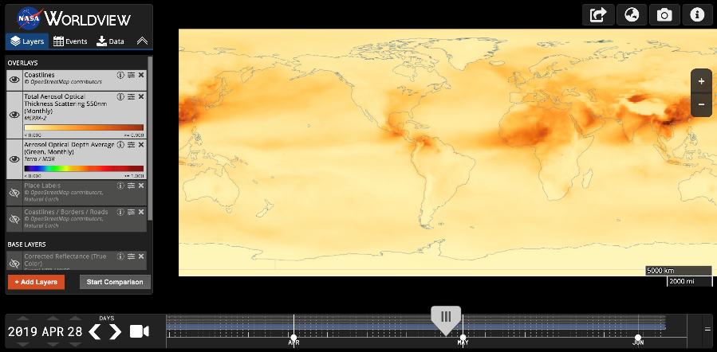





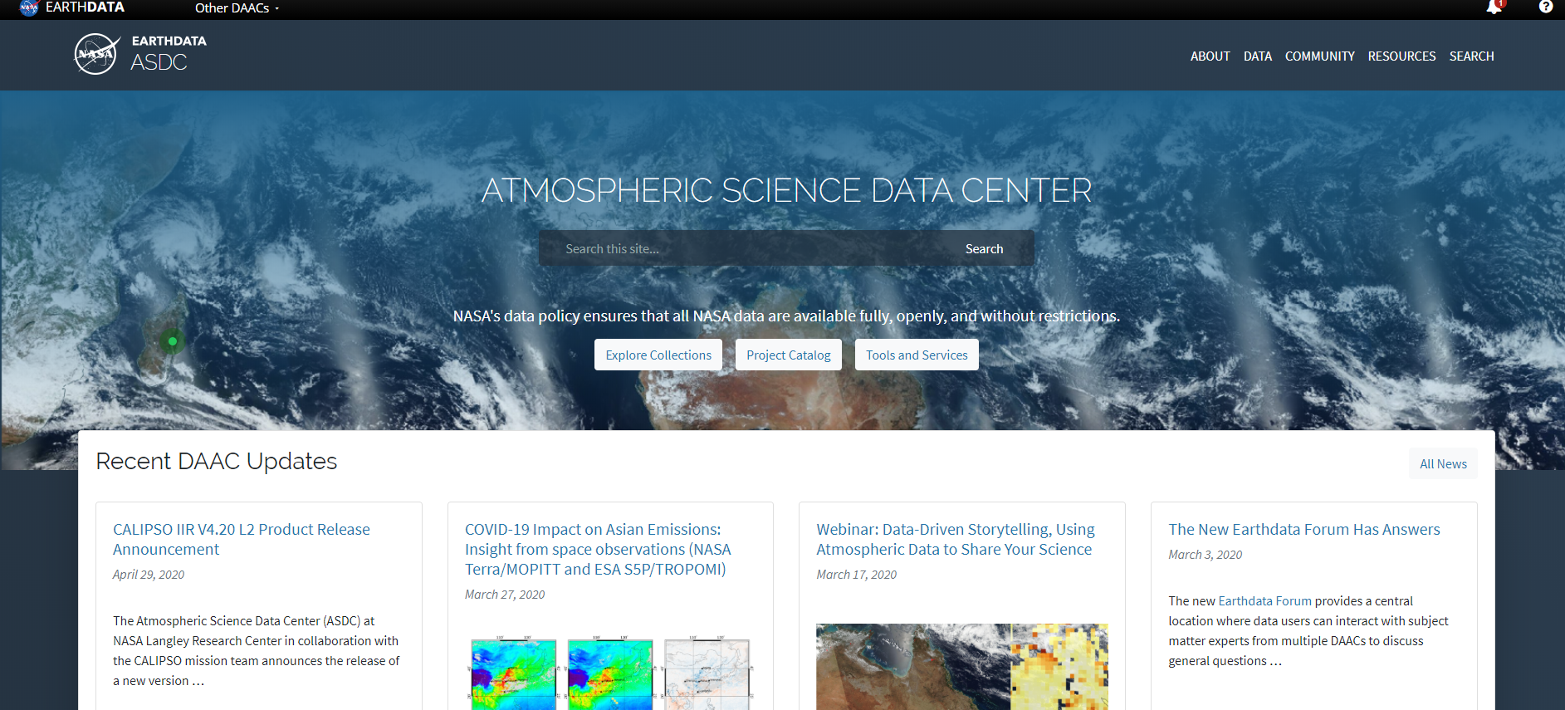
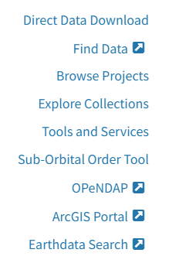



ASDC Data Distribution: Tools and Services
NASA Earthdata Search
⚬ metadata ⚬ browse ⚬ download ⚬ customize ⚬ HTTPS and AWS S3 direct data access
NASA Earthdata WorldView
⚬ visualize ⚬ GIBS API
NASA Earthdata Harmony
⚬ transform ⚬ subset ⚬ reformat
NASA Earthdata GIS
⚬ ArcGIS Image & Feature Service ⚬ OGC WMS, WFS & WCS
OPeNDAP
⚬ transform ⚬ subset ⚬ reformat
ASDC Subsetters
⚬ subset ⚬ aggregate
User Support and Other Resources
Example scripts
⚬ Python/Jupyter Notebook ⚬ R scripts
⚬ contributed tutorials/scripts
Earthdata Forum https://forum.earthdata.nasa.gov/
ASDC User Support support-asdc@earthdata.nasa.gov
https://asdc.larc.nasa.gov/
Notes:
Earthdata Login https://urs.earthdata.nasa.gov

Slide 3
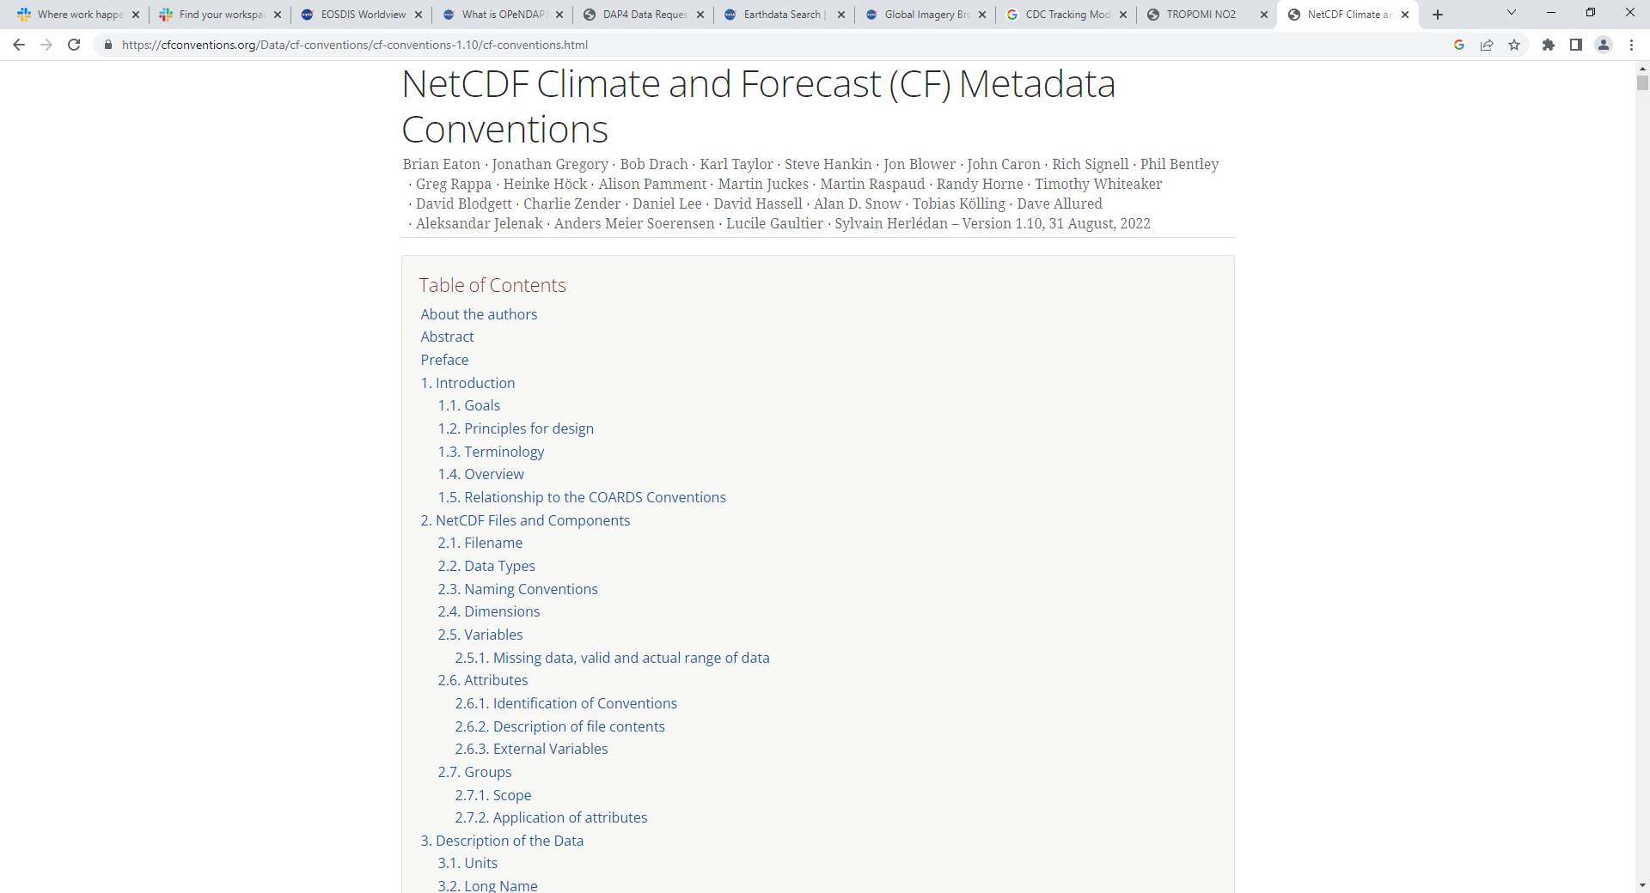
Coordination on Climate and Forecasting (CF) Conventions
ASDC worked with TEMPO team to make products as CF compatible as possible
Increased compatibility and interoperability of data products in tools & applications!
https://cfconventions.org/

Slide 4
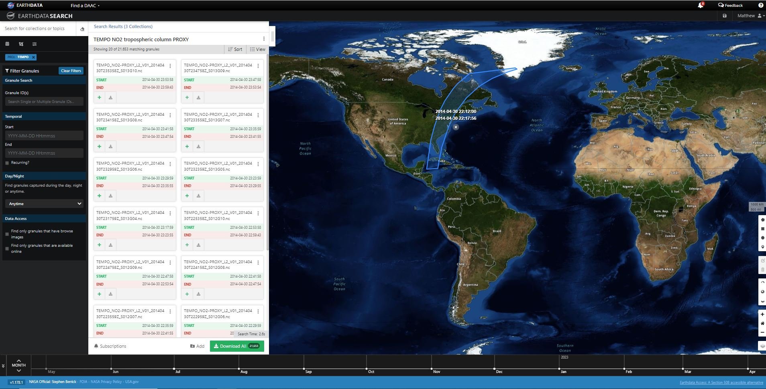
Earthdata Search
Search and Order Data From
On Premise at ASDC
Amazon Web Services (AWS)
Harmony
Subsetting & Aggregation
Reprojection
Regridding
File Conversions
Browse Imagery
Global Imagery Browse Service (GIBS)
Application Programming Interface (API) Access
https://search.earthdata.nasa.gov

Slide 5
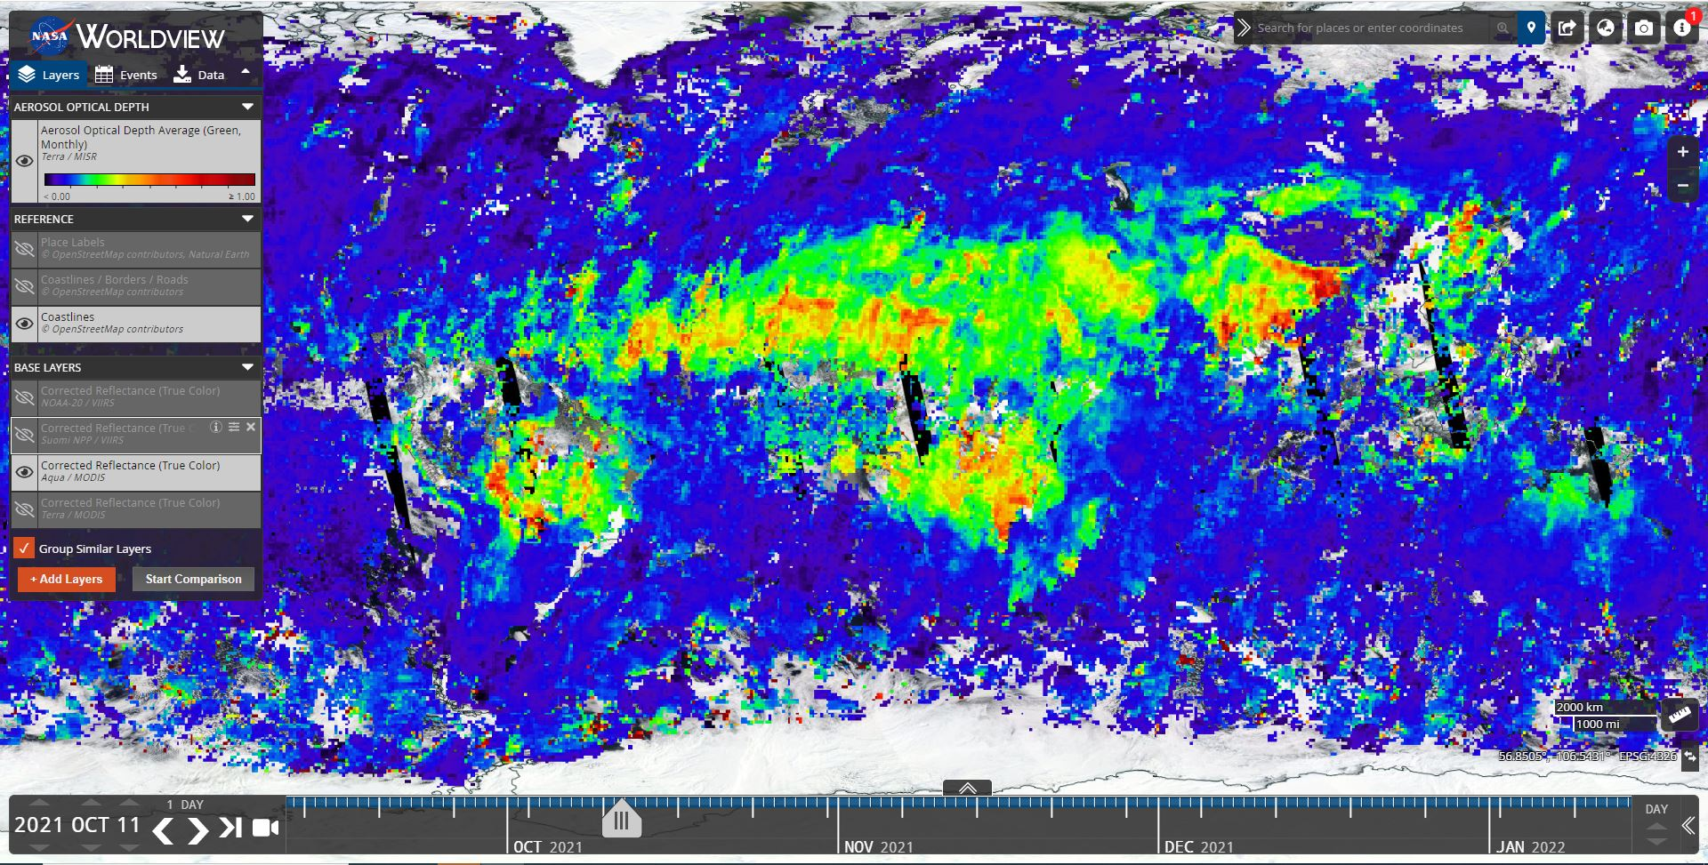
Worldview / Global Imagery Browse Service (GIBS)
Browse Imagery
Set Thresholds
Animations
Event Information
Global Imagery Browse Service (GIBS) API
Web Map Tile Service (WMTS)
Tiled Web Map Service (TWMS)
Web Map Service (WMS)
https://worldview.nasa.gov
https://www.earthdata.nasa.gov/eosdis/science-system-description/eosdis-components/gibs

Slide 6
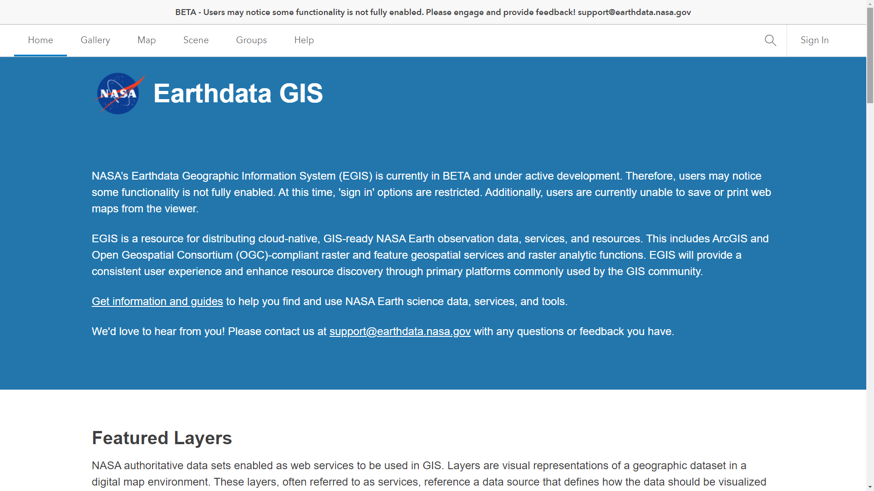
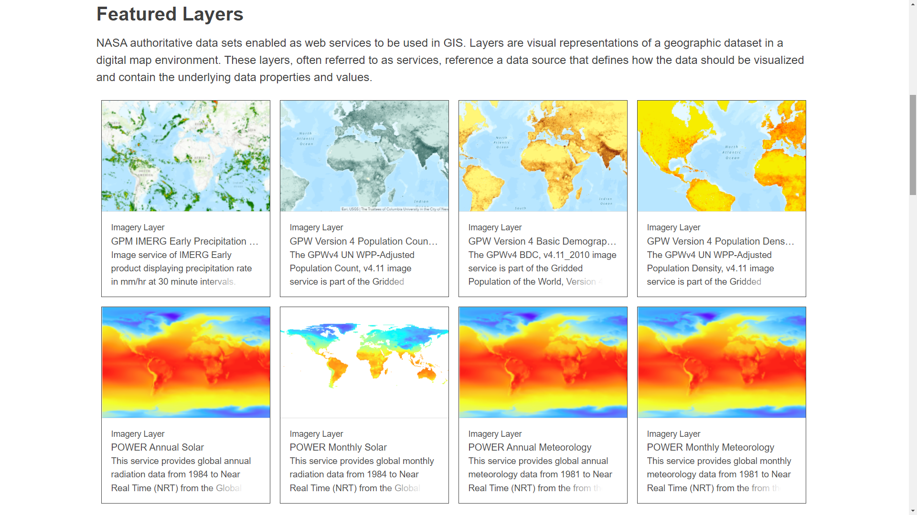
Earthdata GIS
ArcGIS Image Services
ArcGIS Feature Services
Open Geospatial Consortium (OGC)
Web Map Service (WMS)
Web Coverage Service (WCS)
Web Feature Service (WFS)
Web Maps
Web Applications
https://gis.earthdata.nasa.gov

Slide 7
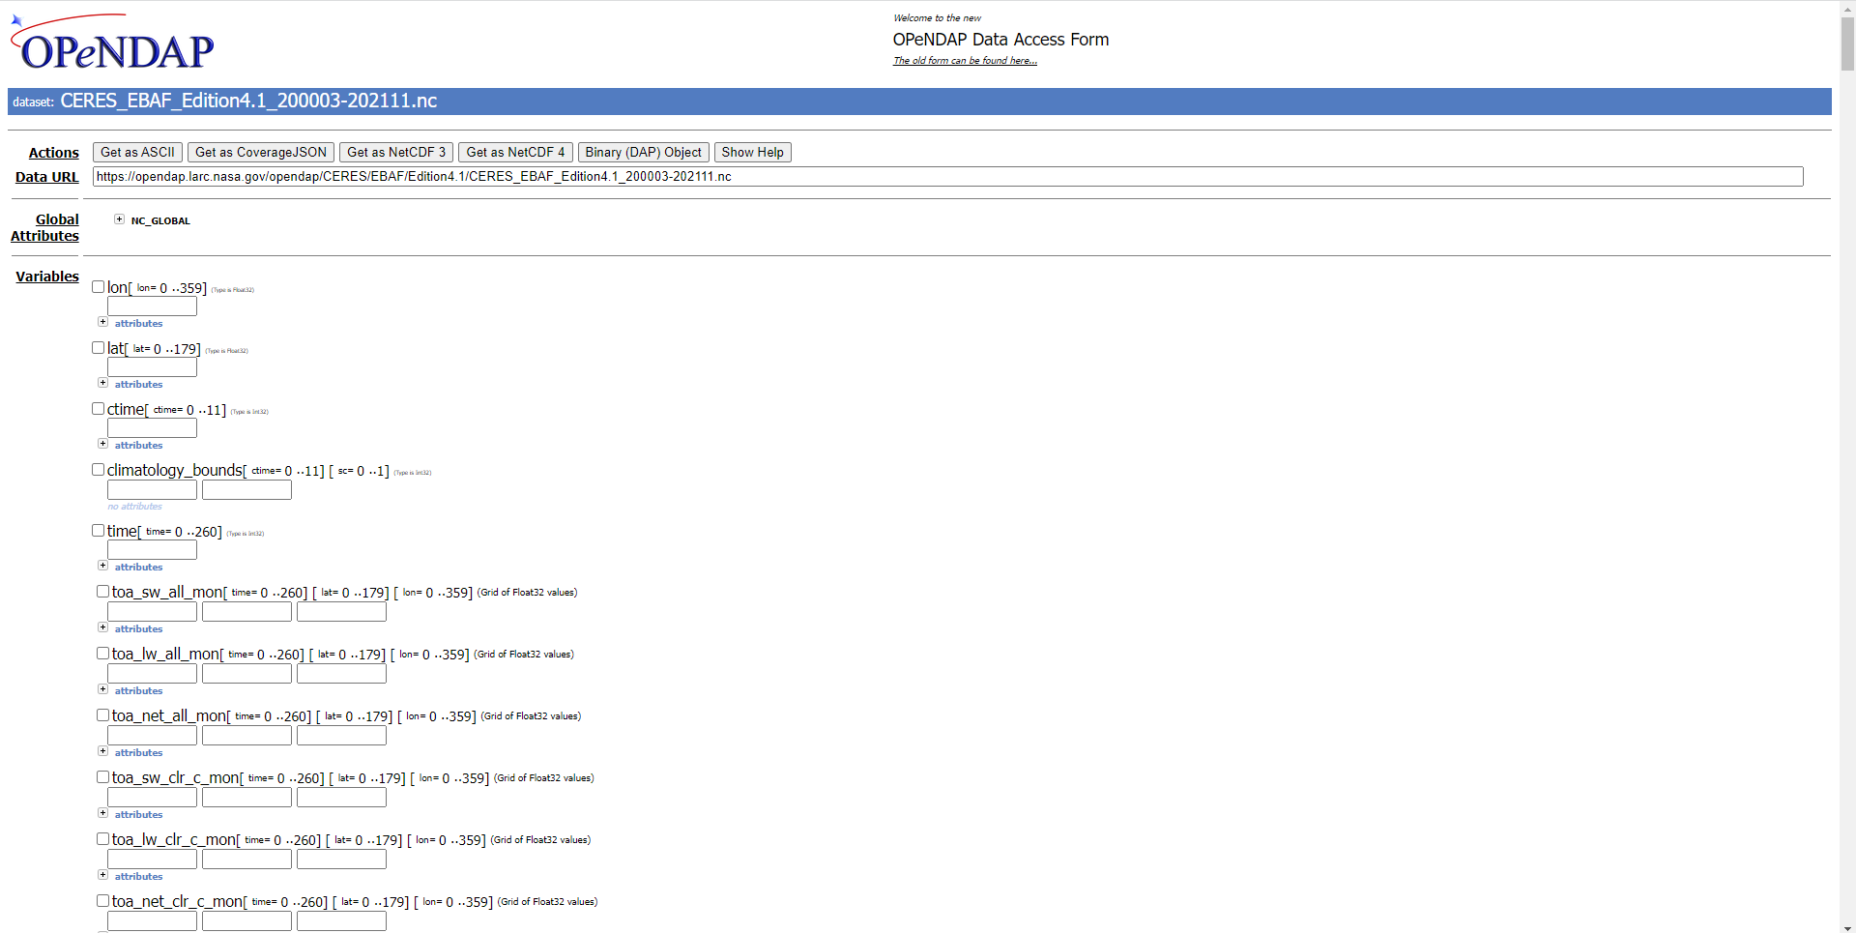
OPeNDAP
API Access
Subsetting & Aggregation
File Conversions
Can be Accessed Through:
ArcGIS
Matlab
Ferret
GrADS
IDV
Panoply
Python, R, Java, C
https://opendap.larc.nasa.gov
https://opendap.earthdata.nasa.gov

Slide 8
ASDC Subsetters
On Premise at ASDC
API Access
Subsetting & Aggregation
File Conversions
https://subset.larc.nasa.gov

Slide 9
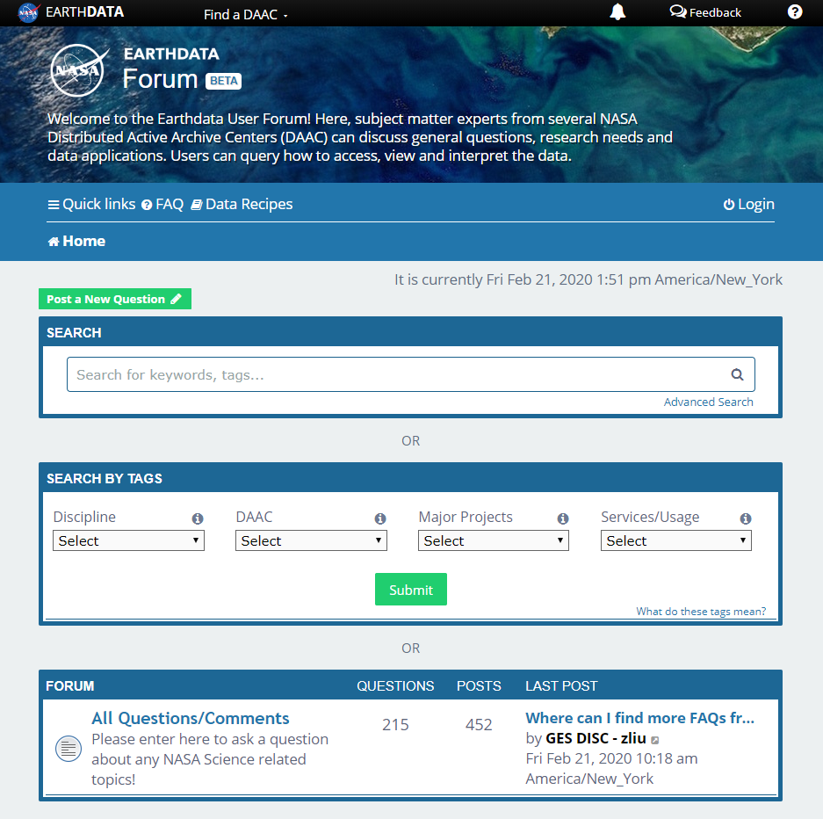
Earthdata Forum
Science Data Users can seamlessly search for information even if they do not know which DAAC the data belongs to.
Scientists & Data Providers can effectively assist their user community in more accurately using their products.
DAACs & Subject Matter Experts (SMEs) can quickly link users to existing resources.
DAAC User Services can swiftly provide inquirers with an authoritative source related to DAAC data products & services.
https://forum.earthdata.nasa.gov

Slide 10
Atmospheric Science Data Center
NASA Langley Research Center
Hampton, Virginia (USA)
https://asdc.larc.nasa.gov/
support-asdc@earthdata.nasa.gov

